Slide 1
Scaling FMM with Data-Driven OpenMP Tasks on Multicore Architectures
Abdelhalim Amer (Halim)¹, Satoshi Matsuoka², Miquel Pericàs³, Naoya Maruyama⁴, Kenjiro Taura⁵, Rio Yokota², and Pavan Balaji¹
¹ Argonne National Laboratory, USA
² Tokyo Institute of Technology, Japan
³ Chalmers University of Technology, Sweden
⁴ RIKEN Advanced Institute of Computational Science, Japan
⁵ University of Tokyo, Japan
IWOMP 2016, 12th International Workshop on OpenMP, Oct 05-07, 2016

Slide 2
Dynamic Irregular Methods
Characteristics
Irregular data access patterns
Complex flow control
Imbalanced workloads
Patterns, flows, and workloads known at run-time
Challenges
Inherent parallelism, but difficult to exploit with regular parallel methods (e.g. parallel loops)
Scalability requirements on modern multicore systems
Fine-grained concurrency
Avoid/reduce bulk-synchronization
Data locality incentives
IWOMP 2016, 12th International Workshop on OpenMP, Oct 05-07, 2016

Slide 3
Parallelization Methods Landscape
High parallel slackness (informally): Parallel work >> P (number of processors)
Over decomposition
Runtime costs: work unit management, dependency tracking, …
Locality opportunity: amenable to locality optimizations
Loop tiling; NUMA-awareness
Overly simplified classification (naïve)
Bulk-Synchronous Coarse-Grained
Bulk-Synchronous Fine-Grained
Async Tasks
Coarse-Grained
Async Tasks
Fine-Grained
Data-Locality Opportunities
Parallel Slackness
Runtime Costs
Goal: Characterize parallelization methods for dynamic irregular methods using FMM as use-case
IWOMP 2016, 12th International Workshop on OpenMP, Oct 05-07, 2016

Slide 4
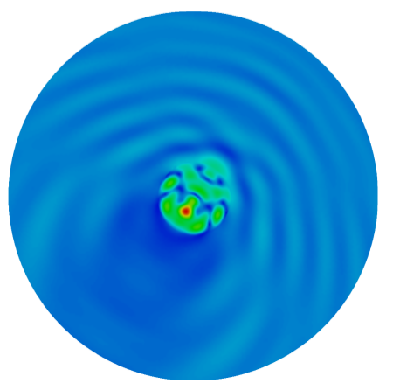
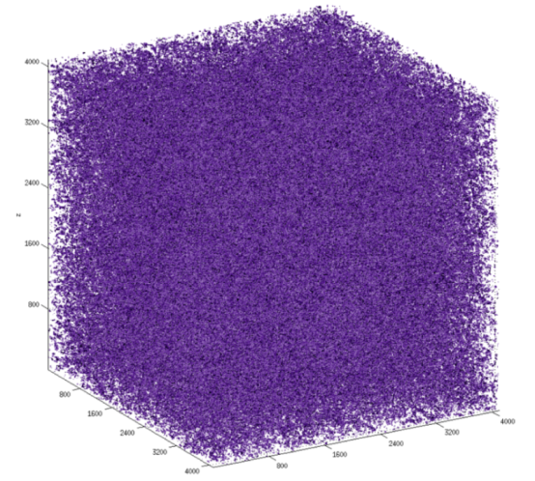
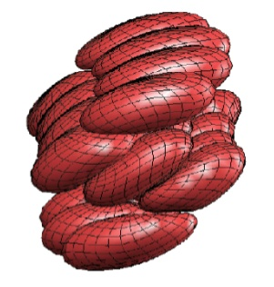
Fast Multipole Methods (FMM)
Solve N-Body problems
O(N) complexity
Dynamic irregular method
Applications in several domains
N-Body Problem
O(N²) interactions
Electro-Dynamics: Multi-Level Fast Multipole BEM for 3-D Elastodynamics, Computer Methods in Applied Mechanics and Engineering 197 (2008)
Blood-Flow: Petascale direct numerical simulation of blood flow on 200k cores and heterogeneous architectures, SC 2010
Fluid Dynamics: Petascale turbulence simulation using a highly parallel fast multipole method on GPUs (2012)
IWOMP 2016, 12th International Workshop on OpenMP, Oct 05-07, 2016

Slide 5
Kernel-Independent FMM: Domain Decomposition
Refined mesh
<= q bodies per box
Building interaction lists, U, V, X, and W
IWOMP 2016, 12th International Workshop on OpenMP, Oct 05-07, 2016

Slide 6
Kernel-Independent FMM: Data Structures
1D breadth-first representation of the tree
1) Meta Data
Interaction lists
U: 6,22,24,…
V: 21,23,…
X: 12,18,…
W: 43,44,…
2) Computational Data
Source bodies
Target bodies
Equivalent Density
Check surface
…....
IWOMP 2016, 12th International Workshop on OpenMP, Oct 05-07, 2016

Slide 7
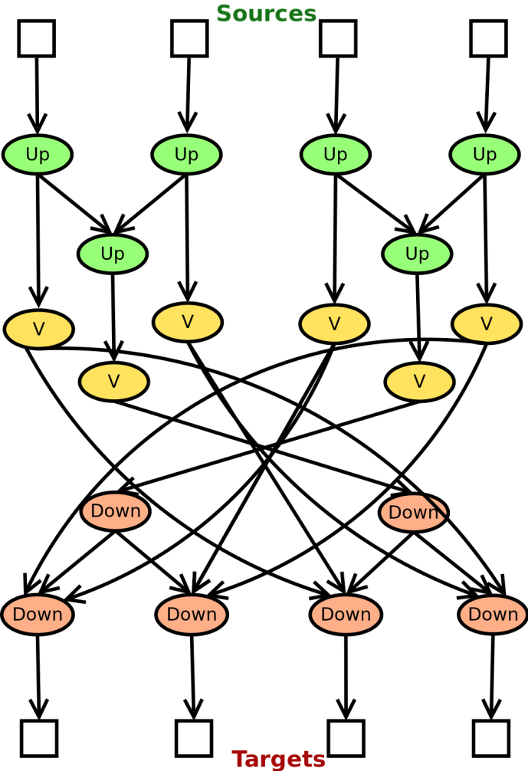
KI-FMM Computational Patterns (1/2)
Source Nodes
DAG
Source Upward Equivalent
0 | 1 | 2 | 3 | 4 | 5 | 6 | 7 | 8 | 9
0 | 1 | 2 | 3 | 4 | 5 | 6 | 7 | 8 | 9
Target Downward Check
Target Nodes
Far-field computation fine-grained task graph
Relative data structures
IWOMP 2016, 12th International Workshop on OpenMP, Oct 05-07, 2016

Slide 8
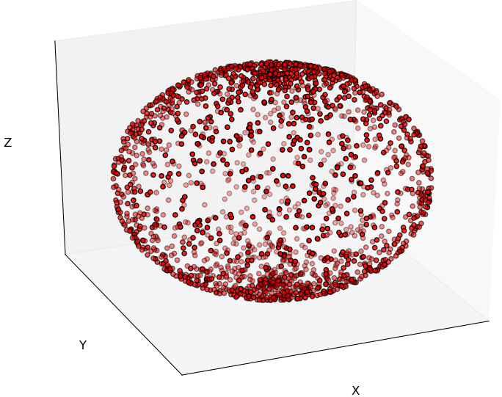
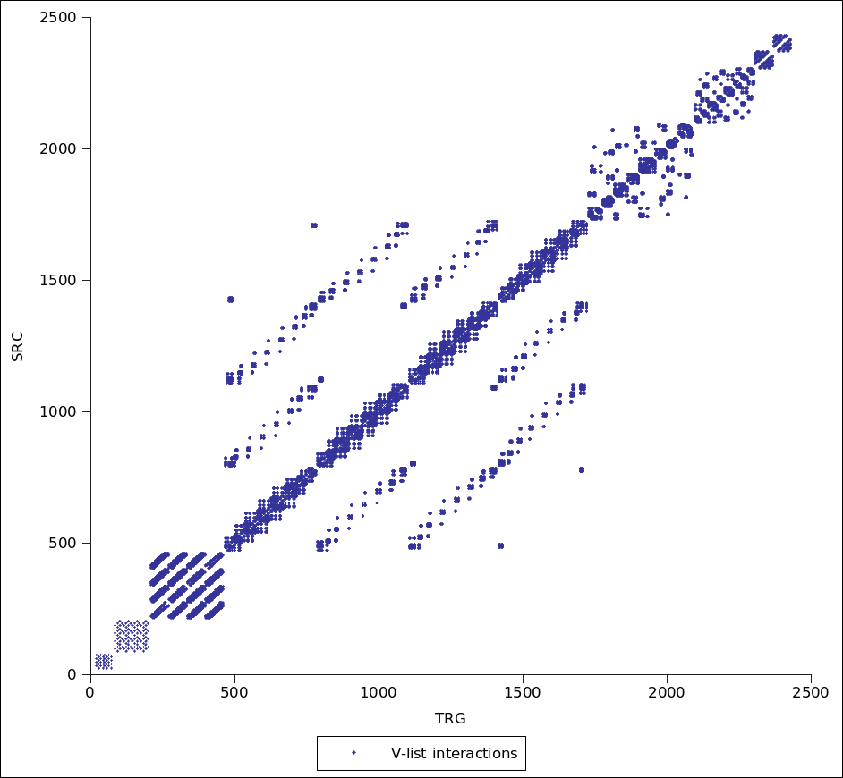
KI-FMM Computational Patterns (2/2)
Most fine-grained tasks operate on single (src, trg) pair of boxes
Various types of computation
Pairwise interactions (U-list, upward, …)
DGEMMs (upward, downward)
FFTs (V-list)
Pointwise products (V-list)
Elliptical body distribution
Each point is a pointwise product
Loads 96KB
Does 16K DP floating point ops
V-List computational pattern adjacency matrix
IWOMP 2016, 12th International Workshop on OpenMP, Oct 05-07, 2016
Notes:
point wise multiplication (Hadamard product) of complex vectors
z = x * y
|z| = |x| = |y| = np * 2 * sizeof(double) = 2016 * 2 * 8 = 32 KB
Total data per multiplication: 32KB * 3 = 96KB
Total operations: np * 2 (complex number) * 4 ops = 16K ops
Theoretical arithmetic intensity = 96/16 = 1/6

Slide 9
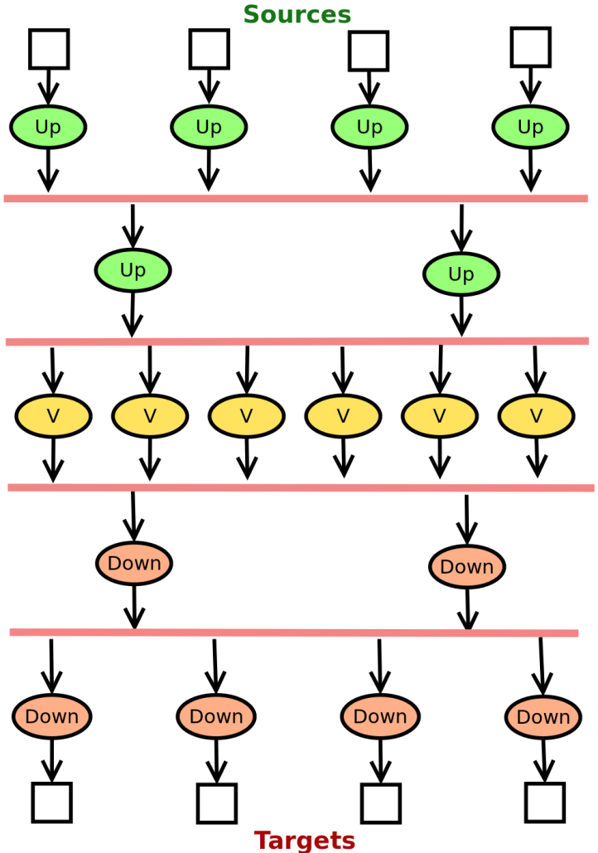
Kernel Independent FMM Implementations
MassiThreads lightweight thread (Task)
OpenMP barrier
Bulk-Synchronous [1]
Fine-Grained Data-Driven [2]
[1] Chandramowlishwaran, Aparna, et al. "Optimizing and tuning the fast multipole method for state-of-the-art multicore architectures." Parallel & Distributed Processing (IPDPS), 2010 IEEE International Symposium on. IEEE, 2010., IPDPS 2010
[2] Amer, Abdelhalim, et al. "Fork-Join and Data-Driven Execution Models on Multi-core Architectures: Case Study of the FMM." Supercomputing. Springer Berlin Heidelberg, 2013.
IWOMP 2016, 12th International Workshop on OpenMP, Oct 05-07, 2016

Slide 10
1D Source- vs. Target-Centric Patterns
READ
READ
WRITE
WRITE
Bulk-Synchronous = target-centric
Fine-Grained Data-Driven = source-centric
IWOMP 2016, 12th International Workshop on OpenMP, Oct 05-07, 2016
Notes:
point wise multiplication (Hadamard product) of complex vectors
z = x * y
|z| = |x| = |y| = np * 2 * sizeof(double) = 2016 * 2 * 8 = 32 KB
Total data per multiplication: 32KB * 3 = 96KB
Total operations: np * 2 (complex number) * 4 ops = 16K ops
Theoretical arithmetic intensity = 96/16 = 1/6

Slide 11
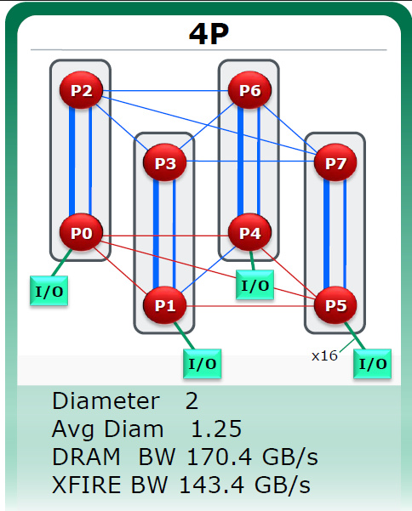
Scalability Collapse
~3x
AMD Magny-Cours (Hotchips 2009 presentation)
+ GCC 4.9.2
IWOMP 2016, 12th International Workshop on OpenMP, Oct 05-07, 2016

Slide 12
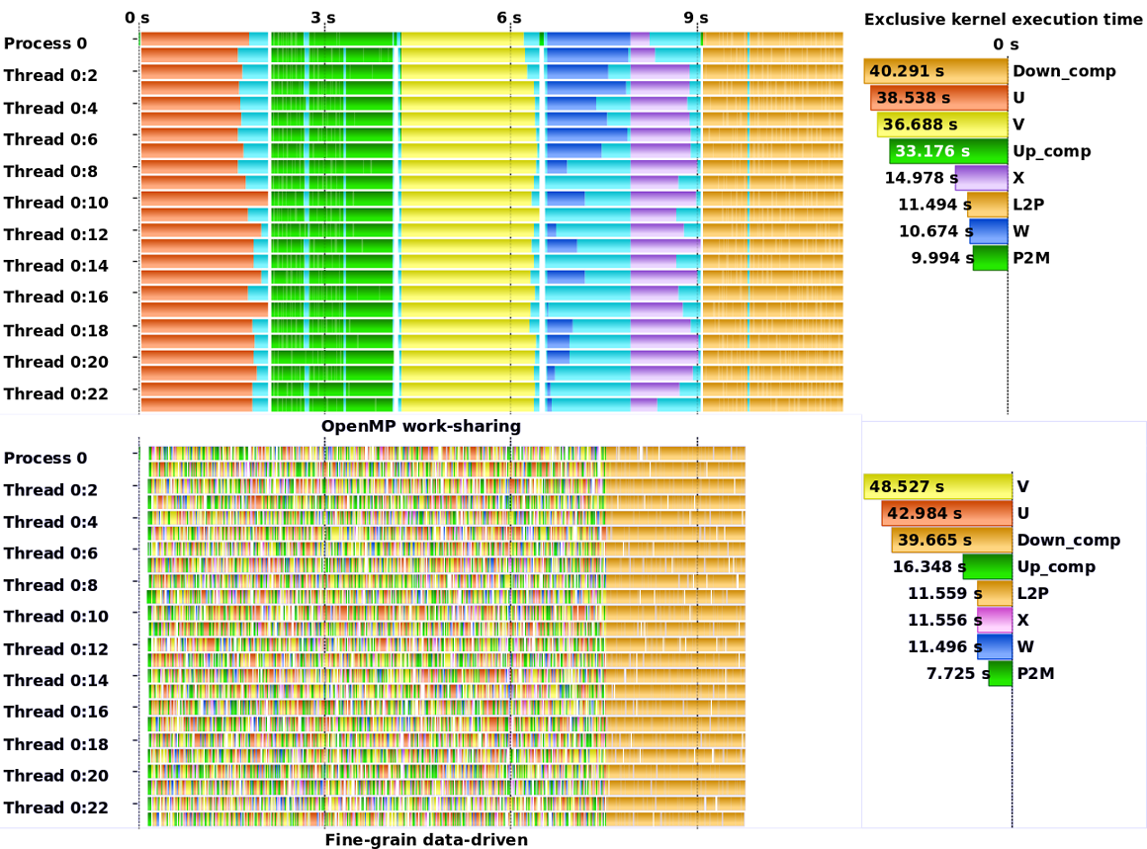
Parallel Slackness & Data Locality Tradeoffs
Significant idleness from bulk-synchronous steps and static scheduling
Data
movement
Data-Driven effectively eliminates idleness
Improves tree-producer-consumer data reuse
Makes things worse for communication intensive kernel (V)
IWOMP 2016, 12th International Workshop on OpenMP, Oct 05-07, 2016

Slide 13
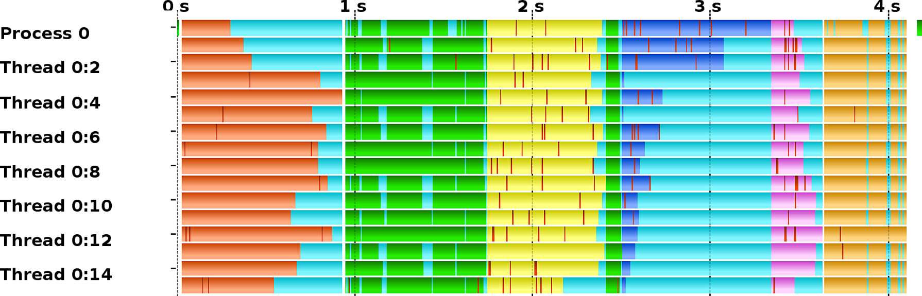
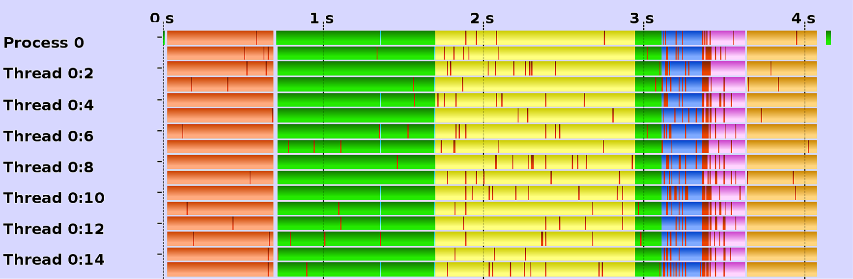
Static vs. Dynamic Scheduling in Bulk-Synchronous
void * V-list-phase (){
// Traverse all target nodes in parallel
# pragma omp parallel for schedule ( OMP_SCHED )
for ( trg =0; trg < trgNodeMax ; trg ++){
// Accumulate the contribution of all
// source nodes into the target
for ( src in Vlist ( trg ))
compute_V ( trg , src );
}
} // Implicit Barrier Synchronization
Static
Dynamic
Static
Dynamic
IWOMP 2016, 12th International Workshop on OpenMP, Oct 05-07, 2016

Slide 14
Optimizing for Cache First
2-Socket Sandy Bridge EP
Facts on a 2-socket Sandy Bridge EP
64B strided memory accesses drop BW by 4x
Remote memory accesses drop BW by 2x
Rule of thumb: optimize for cache before optimizing for NUMA
NUMA-awareness in KIFMM is challenging
Difficulty to keep data local across stages
Current implementation: some data is first-touched by a single thread, other touched by multiple threads
1
2
1
2
3
4
QPI
3
4
5
6
5
6
7
8
7
8
V-list and U-list arithmetic intensity (with respect to DRAM accesses) on the roofline model of Sandy Bridge EP
IWOMP 2016, 12th International Workshop on OpenMP, Oct 05-07, 2016

Slide 15
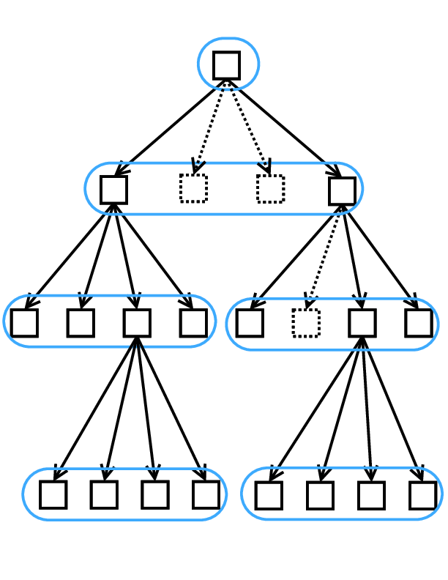
2D Tiling of Computational Patterns
Two main goals
Spawn work units with high data locality potential
Control granularity (unlike the lightweight thread implementation)
Data Partitioning has to take into account the tree data structure
2D V-list Partitioning
IWOMP 2016, 12th International Workshop on OpenMP, Oct 05-07, 2016

Slide 16
Tiled Dynamic Bulk-Synchronous Implementation
2-dimensional tiling of each parallel loop
Same tile (block) size across all loops
void * V-list-phase (){
// Traverse all target blocks in parallel
# pragma omp parallel for schedule ( dynamic )
for ( i =0; i < trgNodeMax ; i += BS ){
// Traverse all source blocks
for ( j =0; j < srcNodeMax ; j += BS ){
// Traverse the targets in the block
for ( trg = i ; trg < BS ; trg ++){
// Traverse the sources in the block
for ( src = j ; src < BS ; src ++){
// Accumulate the contribution of all
// source nodes into the target
if ( src in Vlist ( trg ))
compute_V ( trg , src );
}
}
}
} // Implicit Barrier Synchronization
}
Block Size
IWOMP 2016, 12th International Workshop on OpenMP, Oct 05-07, 2016

Slide 17


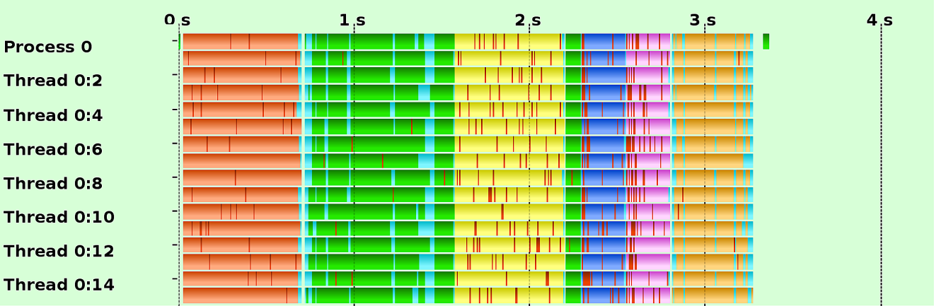
Tuning and Analysis of the Tiled Bulk-Synchronous Method
Static
Sandy Bridge EP
Dynamic
Magny-Cours
Dynamic + Tiling
Tuning the Block Size (BS)
IWOMP 2016, 12th International Workshop on OpenMP, Oct 05-07, 2016

Slide 18
Tiled Implementation with OpenMP Tasks
Executed within #pragma omp parallel
{
#pragma omp single
}
# define DATA_OUT eff_val [beg_eval : trg_stride]
# define DATA_IN eff_den [beg_eden : src_stride]
void * V - list - phase ( trg ){
// Traverse all target blocks
for ( i =0; i < trgNodeMax ; i += BS ) {
int trg_stride = eff_trg_size * BS ;
int beg_eval = trg_stride * i ;
// Traverse all source blocks
for ( j =0; j < srcNodeMax ; j += BS ) {
int src_stride = eff_src_size * BS ;
int beg_eden = src_stride * j ;
# pragma omp task depend (out:DATA_OUT) depend(in: DATA_IN )
// Traverse the target V-list blocks
for (n=i; n < i+BS; n+=VBS)
// Traverse the source V-list blocks
for (m=j; m < j+BS; m+=VBS)
// Traverse targets in a V-list block
for (trg=n; trg < n+VBS; trg ++)
// Traverse sources in a V-list block
for (src=m; src < m+VBS; src ++)
// Accumulate the contribution of all
// source nodes into the target
if (src in Vlist(trg))
compute_V(trg ,src);
}}}
IN/OUT dependencies
on array sections
Second tiling factor for V-list
to reduce cache-thrashing
Async
Task
IWOMP 2016, 12th International Workshop on OpenMP, Oct 05-07, 2016

Slide 19
2D Tuning of the Data-Driven OpenMP Tasking Method
2²² bodies; q = 256
Full concurrency
Compilers: ICC 15 (Sandy Bridge) and GCC 4.9.2 (Magny-Cours)
Sandy Bridge EP (24 threads)
Magny-Cours (48 threads)
Uniform
Elliptical
IWOMP 2016, 12th International Workshop on OpenMP, Oct 05-07, 2016

Slide 20
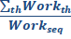
Profiling Idleness and Work-Time Inflation on Sandy Bridge EP
2²² bodies; q = 256
Full concurrency
Compilers: ICC 15 (Sandy Bridge) and GCC 4.9.2 (Magny-Cours)
Bulk + Static
Bulk +
Dynamic
Fine-grained
Data-Driven
Tiled Bulk +
Dynamic
Tiled OpenMP
Data-Driven Tasks
Profiling Work-Time Inflation (WTI) [1]
r =
Profiling Parallel Idleness
(metric = concurrently running tasks)
[1] Stephen L. Olivier, Bronis R. De Supinski, Martin Schulz, and Jan F. Prins. Characterizing and mitigating work time inflation in task parallel programs. Scientific Programming, 21(3):123–136, 2013.
IWOMP 2016, 12th International Workshop on OpenMP, Oct 05-07, 2016

Slide 21
Strong Scaling Performance Comparison
2²² bodies; q = 256
Full concurrency
Compilers: ICC 15 (Sandy Bridge) and GCC 4.9.2 (Magny-Cours)
Sandy Bridge EP
Magny-Cours
48
Uniform
48
Elliptical
Still not 100% parallel efficiency!
NUMA effects were ignored!
IWOMP 2016, 12th International Workshop on OpenMP, Oct 05-07, 2016

Slide 22
Portability of the Tuning Parameter Values
Sandy Bridge EP; 16 Threads
Tiled implementations tuned for 2²² bodies and q = 256
Tuning parameter
Values still hold
Lack of parallelism
IWOMP 2016, 12th International Workshop on OpenMP, Oct 05-07, 2016

Slide 23
Scalability != Efficiency
Sandy Bridge EP; 16 Threads
Large problem: 2²⁴ bodies
Fine-grained data-driven and dynamic bulk-synchronous scale well but overall execution is slower
IWOMP 2016, 12th International Workshop on OpenMP, Oct 05-07, 2016

Slide 24
Lessons Learnt
Scalability
A dynamic approach requires data-locality incentives to promote data reuse and reduce cache thrashing
Tiling computational patterns proved to be successful with proper tuning
Tuning parameter values are fairly portable across input problem sizes as long as parallel slackness is not hindered significantly
Programmability
Manual tiling is gross and error prone!
Sparse data dependencies are difficult to express
Array sections express unnecessary denpendencies
Looking ahead
Ideally, the runtime should cluster fine-grained tasks to optimize for locality
Fine grained tasks imply high scheduling overhead which makes it very difficult
IWOMP 2016, 12th International Workshop on OpenMP, Oct 05-07, 2016

